Slide 1


Black Friday Sales Prediction
GROUP 215:
Pooja Choudhari
Siddhi Kulkarni
Sagar Ippili

Slide 2
Contents
Objective
Data Explanation
Data Preprocessing
Classification Models
Evaluation and Validation
Conclusion
Hypothesis Testing

Slide 3
Objective And Motivation
Black Friday deals are the most happening events every year in US. Black Friday sales accounts to the highest revenue comparing to a regular day sale of retailers.
This event leading to major revenue turnarounds, left us with many questions like amount of purchases by a consumer, kind of products majority of the consumers are interested in.
Answers to these questions would help us in detecting the purchase pattern and analyzing the consumer purchase behavior.
This can in return award the retailers with predictions for making important business decisions like what category of products are to be increased in the inventory and creative deals to attract more customers along with not losing the old ones.

Slide 4
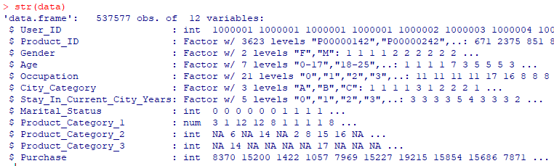
Data Explanation
The dataset downloaded from Kaggle consists of different columns as,
Age: Categorical variable having different age groups as value, example ‘0-17’.
Gender: Categorical variable having ‘M’ for Male and ‘F’ for Female as values.
Stay_In_Current_City_Years: Numerical variable with number of years that particular has been staying.
Marital_Status: Categorical variable having ‘1’ for married and ‘0’ for unmarried.
Purchase: Numerical variable specifying the amount of purchase made.

Slide 5
Data Preprocessing
Notes:
Consider talking about:
Predictive models
Descriptive models
Decision models

Slide 6
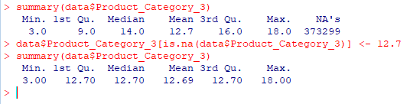
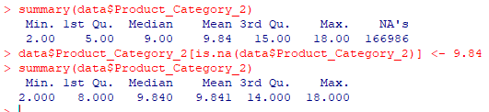
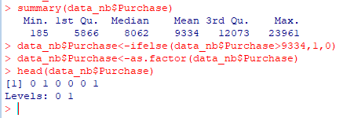
Data Preprocessing: Replacing missing values and Conversion of Dependent variable
Dataset considered has missing values (NA) which needed to be replaced with mean values of the same
Product_Category_2: Replacing the missing values with mean value of the column, i.e 9.84.
Product_Category_3: Replacing the missing values with mean value of the column, i.e 12.7.
Transform the dependent variable, ‘Purchase’ into a dummy variable which has two values, i.e 1 and 0.
Notes:
Consider talking about:
Predictive models
Descriptive models
Decision models

Slide 7
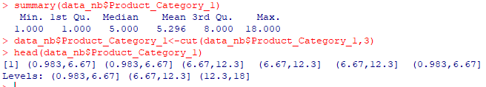
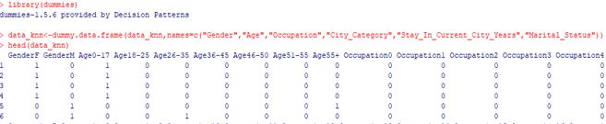
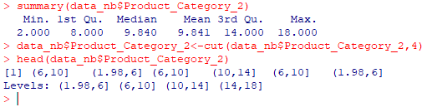
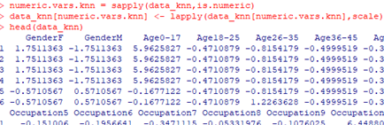
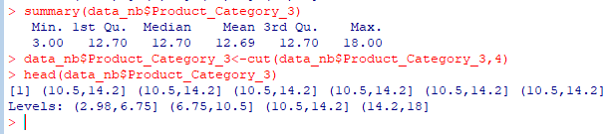
Data Preprocessing for Classification Models
Naïve-Bayes Classification
KNN Classification
Create groups for all the numeric variables using the ‘cut()’ function for building Naïve-Bayes Classification Model.
Create dummy variables for all the categorical variables for building KNN Classification Model.
Notes:
Consider talking about:
Predictive models
Descriptive models
Decision models

Slide 8
Hypothesis Testing
Notes:
Consider talking about:
Predictive models
Descriptive models
Decision models

Slide 9
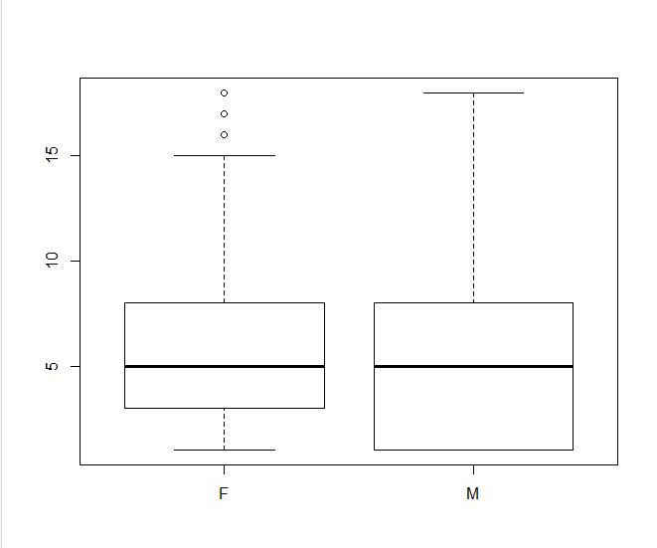
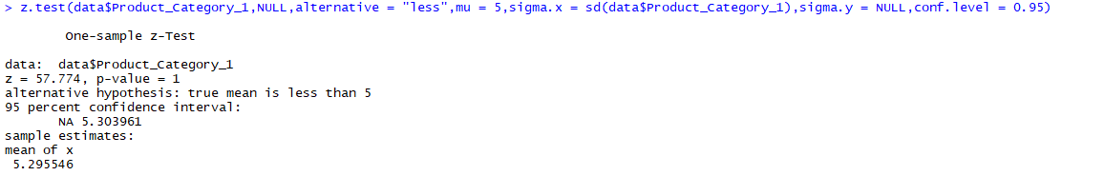
Hypothesis 1
We think that female customers are more likely to purchase more in quantity from products under ‘Product_Category_1’.
Null Hypothesis (H0): Female customers purchase more than 5 in quantity from products under Product_Category_1.
Alternative Hypothesis (Ha): Female customers purchase less than 5 in quantity from products under Product_Category_1.
From the Box-Plot, we can see that the Median(q2) is equal to both the genders.
From the Z-test performed, we can see that the p-value > α, with 95% C.I. Hence, we accept null hypothesis and conclude that Female customers purchase more than 5 in quantity from products under ‘Product_Category_1’.
Notes:
Consider talking about:
Analytical customer relationship management (CRM)
Child protection
Clinical decision support systems
Collection analytics
Cross-sell
Customer retention
Direct marketing
Fraud detection
Portfolio, product or economy-level prediction
Project risk management

Slide 10
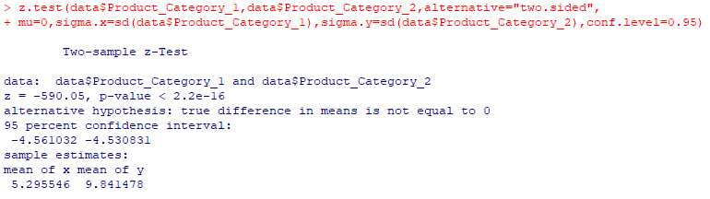
Hypothesis 2
We think that customers will purchase different amount of products from Product_Category_1 and Product_Category_2.
Null Hypothesis (H0): Customers will purchase same amount of products from both Product_Category_1 and Product_Category_2.
Alternative Hypothesis (Ha): Customers will purchase different amount of products from both Product_Category_1 and Product_Category_2.
From the Z-test performed, we can see that the p-value < α, with 95% C.I. Hence, we reject null hypothesis and conclude that customers will purchase different amount of products from both Product_Category_1 and Product_Category_2.
Notes:
Consider talking about:
Analytical customer relationship management (CRM)
Child protection
Clinical decision support systems
Collection analytics
Cross-sell
Customer retention
Direct marketing
Fraud detection
Portfolio, product or economy-level prediction
Project risk management

Slide 11
Classification Models
Notes:
Consider talking about:
Predictive models
Descriptive models
Decision models

Slide 12
Classification Models
We are now, going to build the below mentioned classification models to predict the Purchase, which is our dependent variable.
Naïve-Bayes Classification
KNN Classification
Logistic Regression

Slide 13
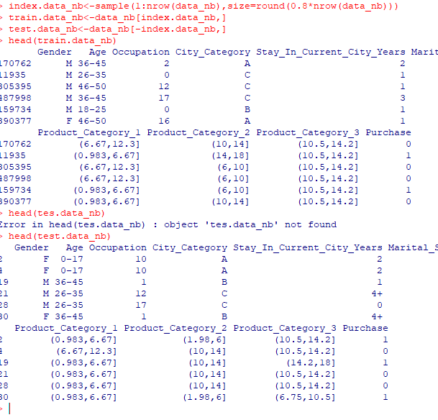
Naïve-Bayes Classification: Data Split
Dataset being very large (approx. 500 thousand records), we will split data into train data and test data for hold-out evaluation.

Slide 14
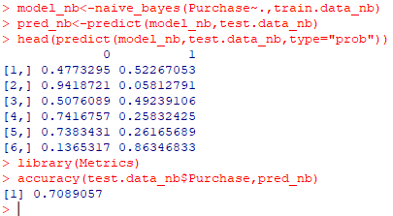
Naïve Bayes Classification: Model Building
Built Naïve-Bayes model on train data and predictions on test data.
We can see that the accuracy of prediction with Naïve Bayes model is 0.7089057 ~ 70.89%
Notes:
Need to add something.

Slide 15
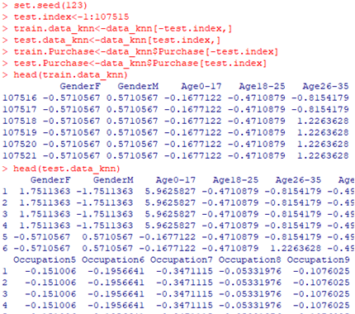
KNN Classification: Data Split
Dataset being very large (approx. 500 thousand records), we will split data into train data and test data for hold-out evaluation.

Slide 16
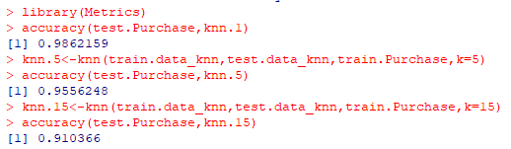
KNN Classification: Model Building
Built different KNN Classification models at K=1,5,15 on train data and predictions on test data.
Finally, we can conclude that the KNN model at k=1 is the best with accuracy 0.9862159 ~ 98.62%
Notes:
Need to add something.

Slide 17
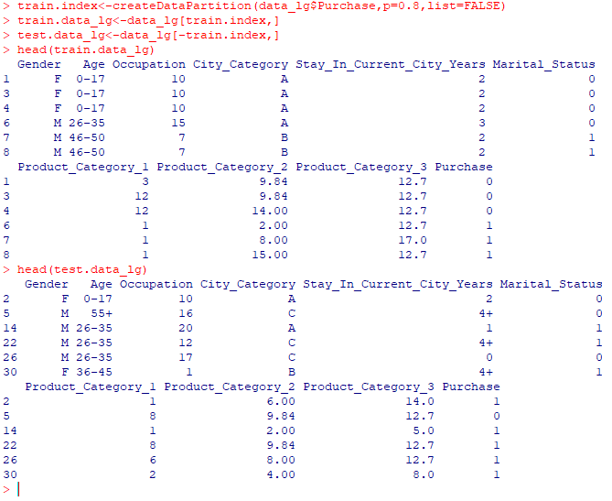
Logistic Regression: Data Split
Dataset being very large (approx. 500 thousand records), we will split data into train data and test data for hold-out evaluation.

Slide 18
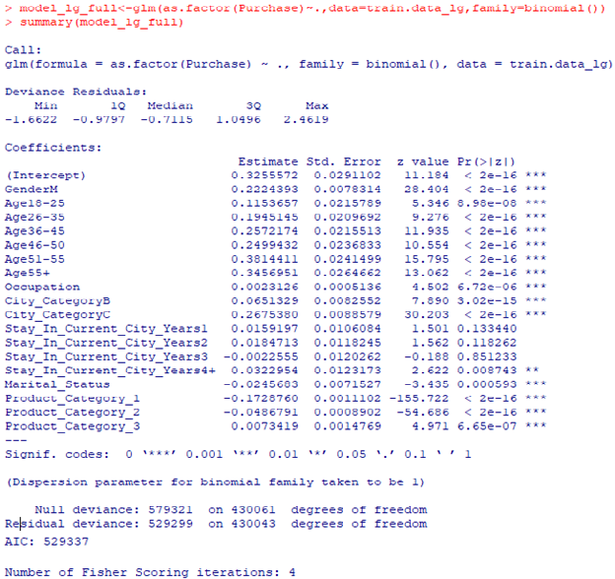
Logistic Regression: Model Building
Built Logistic Regression full model on train data.
We can see that the AIC of full model is AIC:529337
Notes:
Need to add something.

Slide 19
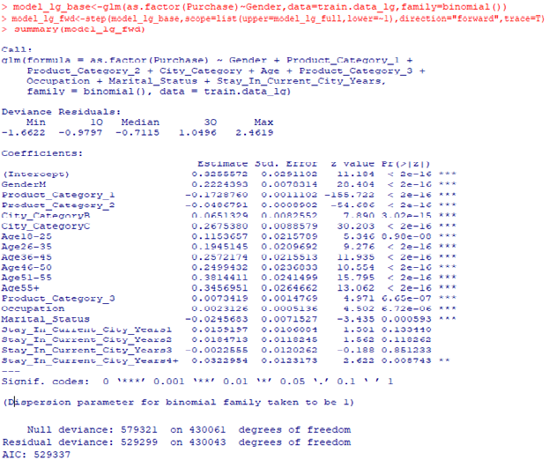
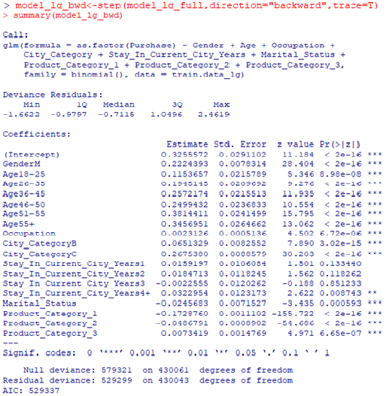
Logistic Regression: Model Building (contd.)
Model with Stepwise Forward
Model with Stepwise Backward
Built a base model with Gender, followed by stepwise forward model resulted AIC: 529337.
Built stepwise backward model using the full model ‘model_lg_full’, resulted AIC: 529337
Notes:
Consider talking about:
Predictive models
Descriptive models
Decision models

Slide 20

Logistic Regression: Best Model
Built Logistic Regression full, stepwise forward and backward models on train data.
We can see that the AIC of all the three models is same, i.e AIC:529337
Finally, we consider the full model on train data and make predictions on the test data to find the accuracy, which resulted 0.7606567 ~ 76.06%
Model | AIC
Full LG | 529337
Stepwise Forward LG | 529337
Stepwise Backward LG | 529337

Slide 21
Evaluation and Validation
Notes:
Consider talking about:
Predictive models
Descriptive models
Decision models

Slide 22
Evaluate Best Classification Model
We build three different classification models to predict the black Friday sale purchase amount.
Accuracies of all the three models are as shown in the table.
Finally, we consider the KNN Classification model the best, which make predictions with the highest accuracy, i.e 0.9862159 ~ 98.62%
Model | AIC (%)
Naïve-Bayes Classification | 70.89
KNN Classification (K=1) | 98.62
Logistic Regression | 76.06

Slide 23
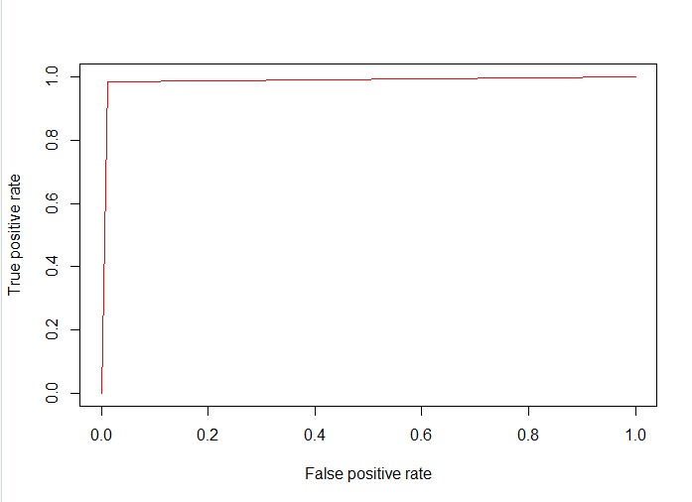
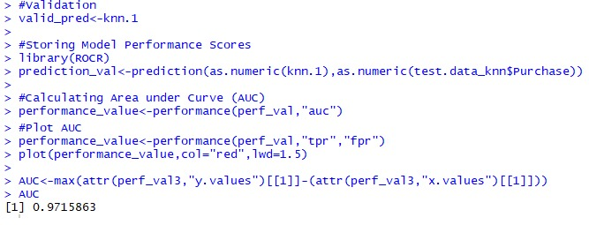
Validation of Best Model
We chose KNN Classification model as the best model among the built models.
We further validated this model using the Area Under the Curve value.
Here, the AUC = 0.9715, which is very near to 1.
Hence, we can say that the KNN Classification model is best model chosen.
Notes:
Will add hypothesis conclusions and final conclusion.

Slide 24
Results and Conclusion
The ulterior motive of this project is to help the retailers to predict the customer’s purchase (higher or lower) on a Black Friday sale, that would help in predicting which gender of a person would buy more and which category of products are high in demand.
The following hypothesis were proven:
Female customers purchase more than 5 in quantity from products under ‘Product_Category_1’.
Customers will purchase different amount of products from both Product_Category_1 and Product_Category_2.
We have build multiple classification models to predict the Purchase, (which is our dependent variable) on the training data and found that KNN Classification model is predicting with the highest accuracy of 0.9862159 ~ 98.62%, using Hold-Out evaluation.
Hence, for a given data that includes gender, city category, stay in current city, product categories, our model with predict the possibility for that particular customer to make higher purchase is 98.62% accurate.
Notes:
Will add hypothesis conclusions and final conclusion.

Slide 25
Thank You..!!

